Slide 1
Bank of Universe
ATM MANAGEMENT SYSTEM
PRESENTED BY :- TEAM 2
Team 2
Abhishek Ranjan
Aravapalli Swarup
Joel Antony
Md Irfan
Nishant
Codes to download-https://github.com/AbishekRanjan/Vishnu.git

Slide 2
Automation Project
Presented by- Team 2
Abhishek
A. Swarup
Irfan
Joel
Nishant

Slide 3
CONTENT
Overview
Requirement
Use case Diagram
Sequence Diagram
Modules
Register
Login
Balance Enquiry
Withdrawal
Deposit
Change pin
Transaction
logout
logout

Slide 4
Overview
The software AMS is to be developed for Automated Teller Machine (ATM).
An Automated Teller Machine is computerized system which will provide a secure platform for customers of banks to perform financial transactions in public places such as roads, malls, offices etc.; without any human intervention.
This system will provide a user-friendly interface to access financial facilities provided by banks.
Hardware Requirements:
Processor :- Intel Pentium 4 or Later or Compatible
RAM :- 1GB or more
Monitor :- SVGA Color Monitor (Touch Screen or Simple)
Pointing Device :- Touch Pad or Keys2.3.
Software Requirements:
Operating System :- Microsoft Windows 7 or Later or Equivalent
Front End :- Eclipse ide
Back End :- Oracle 11g

Slide 5
Requirement
Bank of universe
Login
Register
Logout
current balance- user can check the bank balance with given options.
withdraw- user can withdraw the amount with their own choice of the amount available in their account
deposit- user can credit the amount of their choice.
change pin- user can change their pin code by giving new pin code.
transaction- user can transfer money by entering amount to be sent and the account no. for which they have to transfer the money.
logout- user can exit the page by selecting logout option

Slide 6
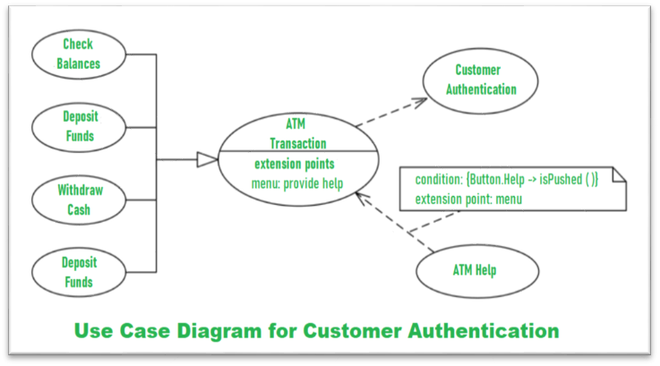
Use Case Diagram

Slide 7
Sequence Diagram
USERS
ATM
DATABASE
NAME
REQ PIN
ENTER PIN
PROCESSING
VERIFY
VALID
OPTIONS
withdraw
Withdraw complete
Receipt

Slide 8
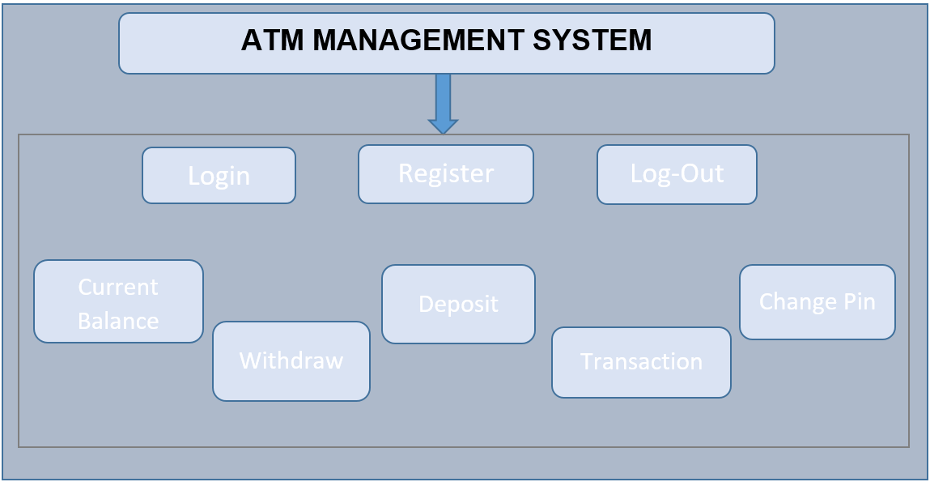
Modules

Slide 9
Register Module
Welcome to the Register page…..
Enter the id:-
Enter the name:-
Enter the Email:-
Enter the Amount:-
Enter the ATM card :-
Enter the Phone No:-
Enter

Slide 10
Login Module
Welcome to the Login page….
Enter your name:-
Enter your pin:-
Enter

Slide 11
Login Main Menu
Login Successful…..
Welcome to Bank of Universe….
Press 1 to check current balance
Press 2 to withdraw
Press 3 to Deposit
Press 4 to change pin
Press 5 for transaction
Press 6 to logout
Enter the choice:
Enter

Slide 12
Balance Enquiry
Enter the choice: 1
Name Xyz Kumar
Balance 6983
AtmCard number 7320882013305240
Mailing-address xyz@abc.com

Slide 13
Withdrawal
Enter the choice: 2
How much cash you want to withdraw : 1000
Name Xyz Kumar
Amount-deducted 1000
New-Balance 10000.0
AtmCard number 7320882013305240
Mailing-address xyz@Abc.com
WITHDRAWAL SUCCESSFULLY DONE!!!!

Slide 14
Deposit
Enter the choice: 3
How much amount you want to added : 1000
Name Xyz Kumar
Amount-Added 1000
New-Balance 10000.0
AtmCard number 7320882013305240
Mailing-address xyz@abc.com
DEPOSIT SUCCESSFULLY DONE !!!!

Slide 15
Change Pin
Enter the choice: 4
Enter new 4 digit pin code : 1234
PIN CODE UPDATED SUCCESSFULLY!!!!

Slide 16
Transaction
Enter the choice: 5
Enter amount for transaction : 1000
Enter correct Account number for transaction : 6296858756781254
TRANSACTION SUCCESSFUL!!!!!

Slide 17
Logout
Main Menu
Enter the choice: 3
Thank you for visiting!!!!!!
May God be with you today and always! I Hope that You
Have a Nice Day
Bank Of Universe....
Login module
Enter the choice:6
Thank you for visiting!!!!!!
May God be with you today and always! I Hope that You
Have a Nice Day
Bank Of Universe.....

Slide 18
Contents:
Home Page
Customer Login Module
Men Module
Women Module
Gear Module
Logout Module
Selenium Codes
Extent Report

Slide 19
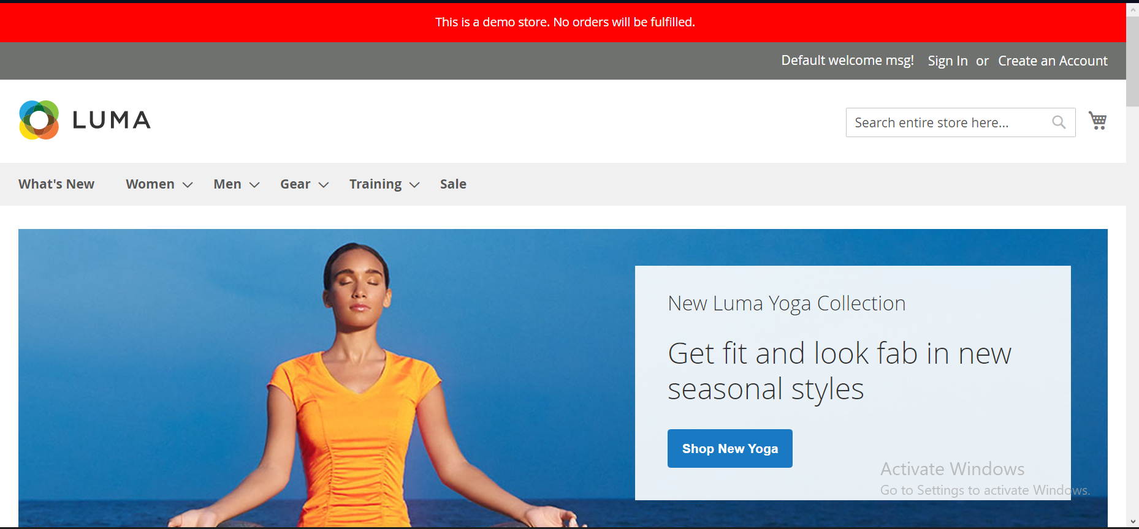
Home Page

Slide 20
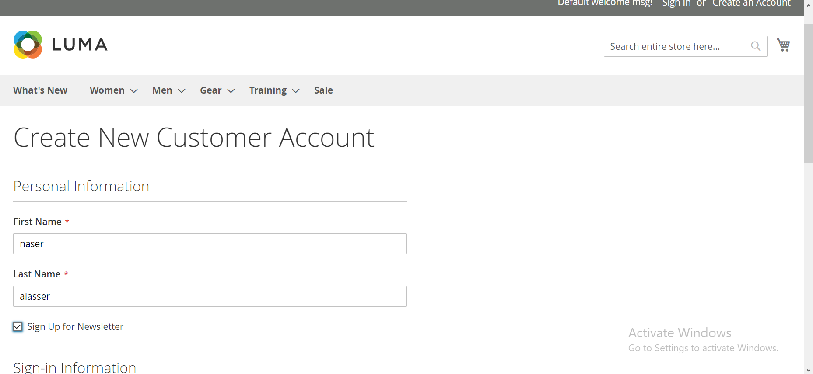
Customer Login Module

Slide 21
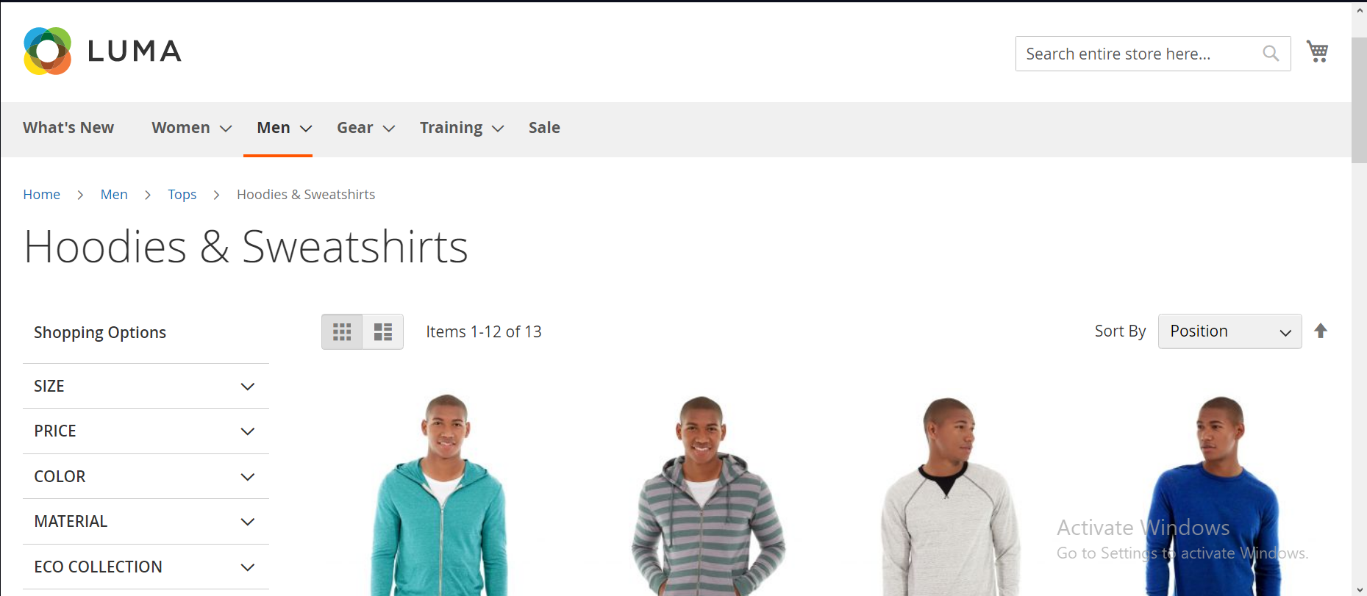
Men Module

Slide 22
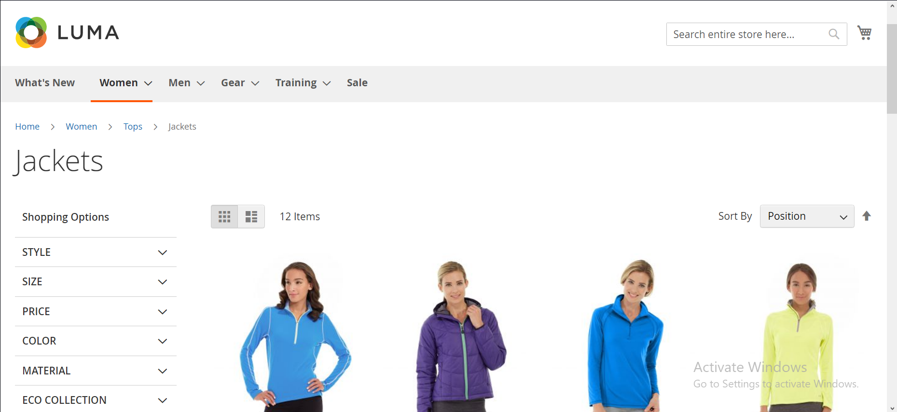
Women Module

Slide 23
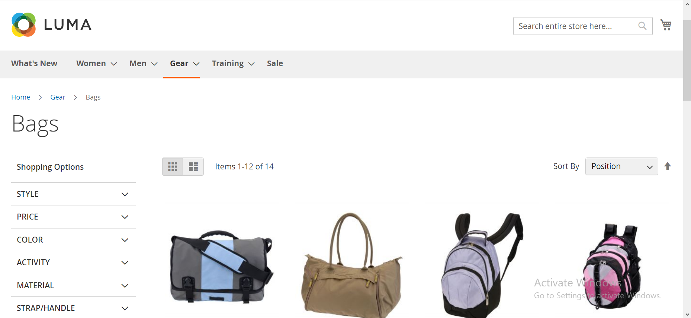
Gear Module

Slide 24
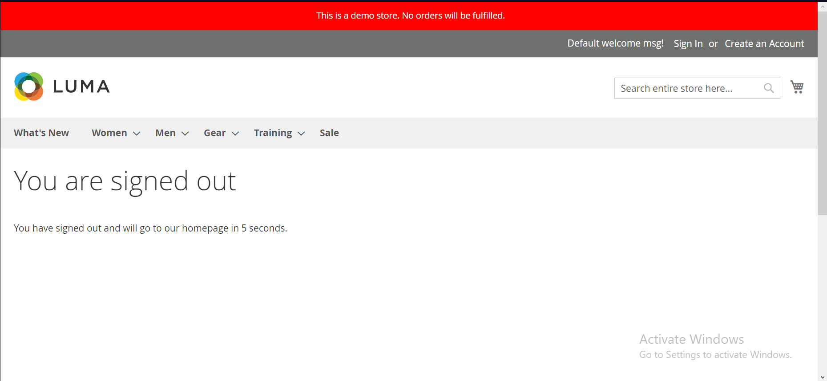
Logout Module

Slide 25
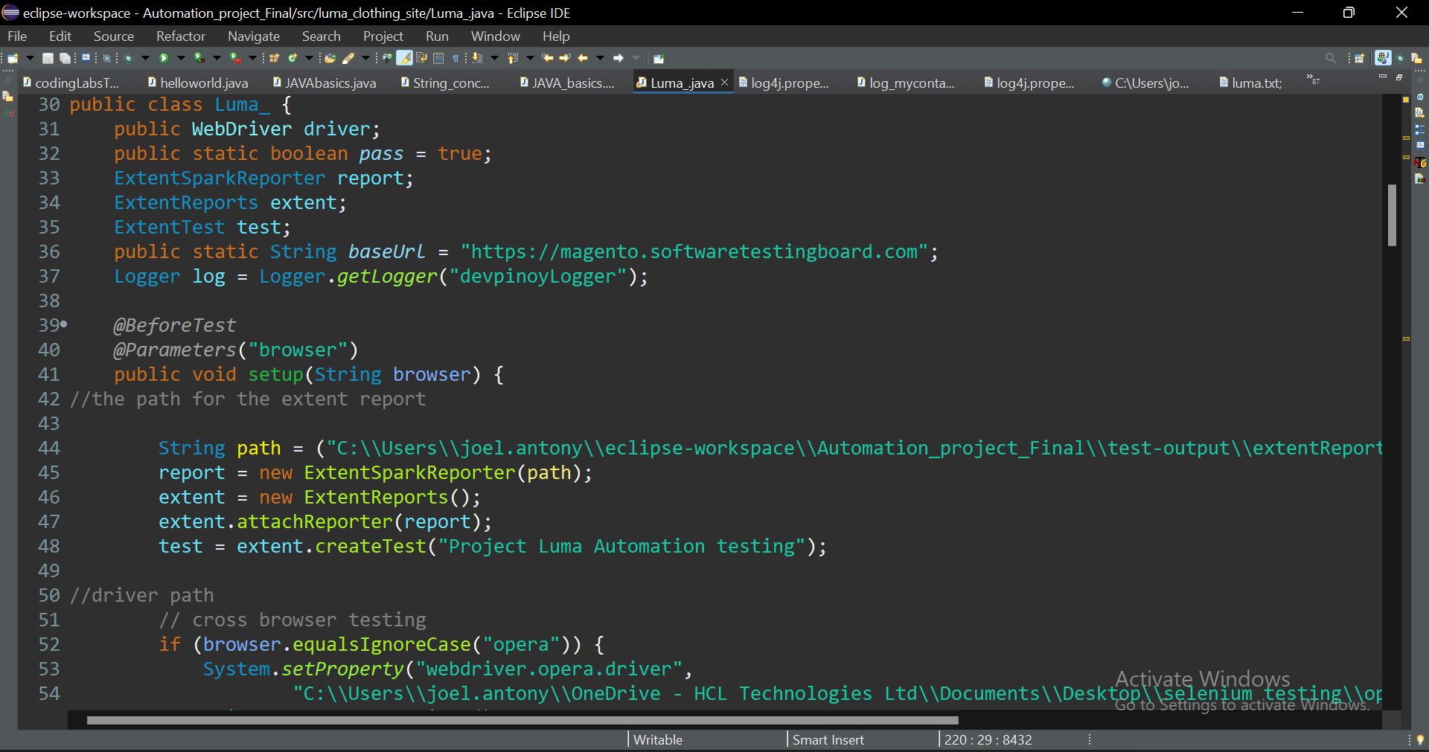
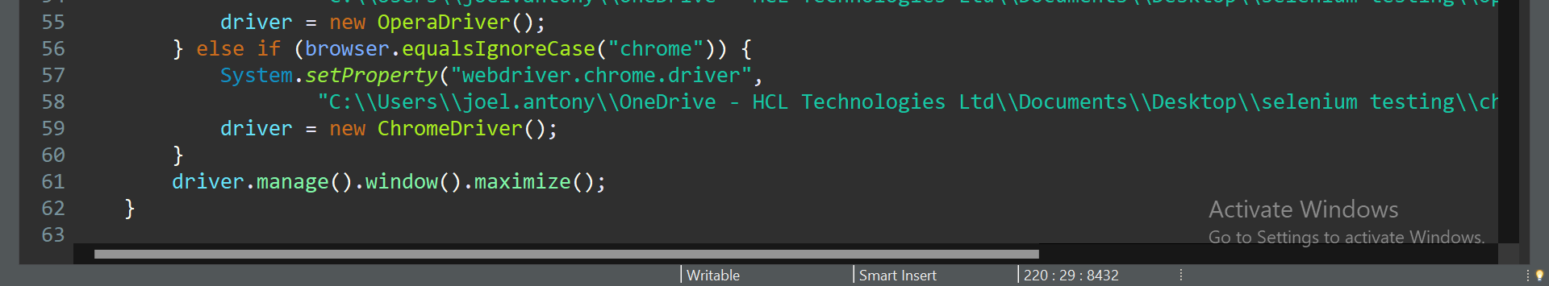
Selenium Codes 1.setup ()-

Slide 26
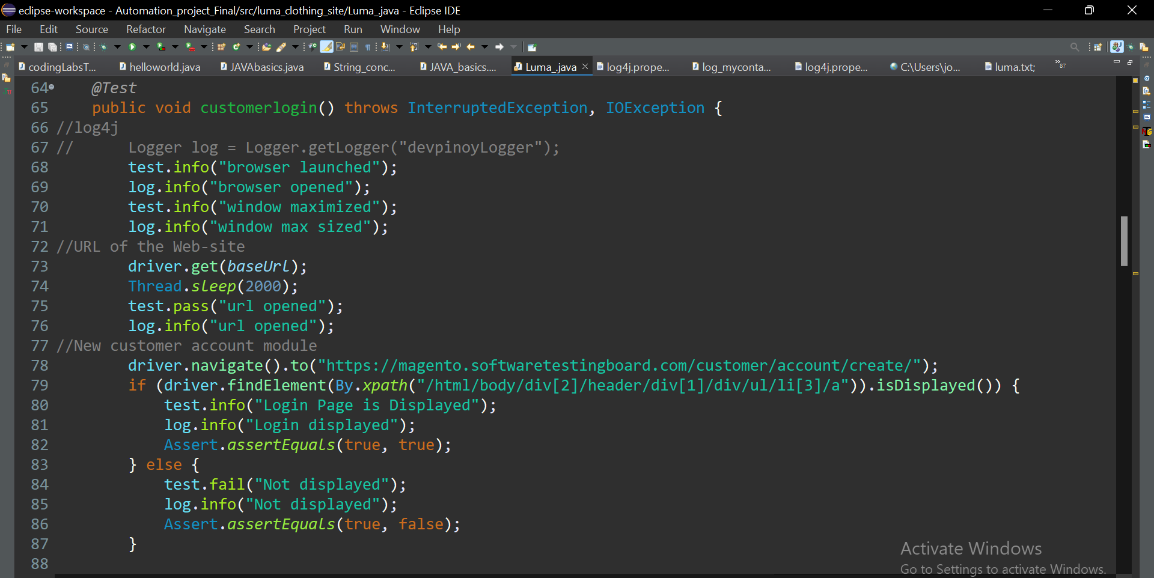
2.Customer login ()-

Slide 27
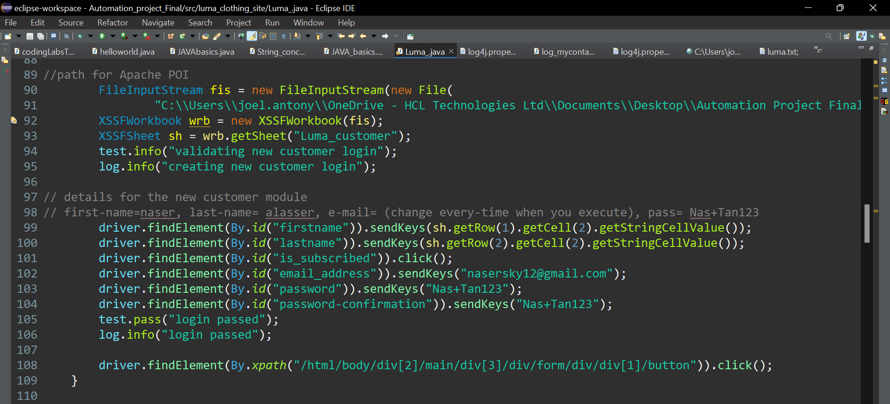

Slide 28
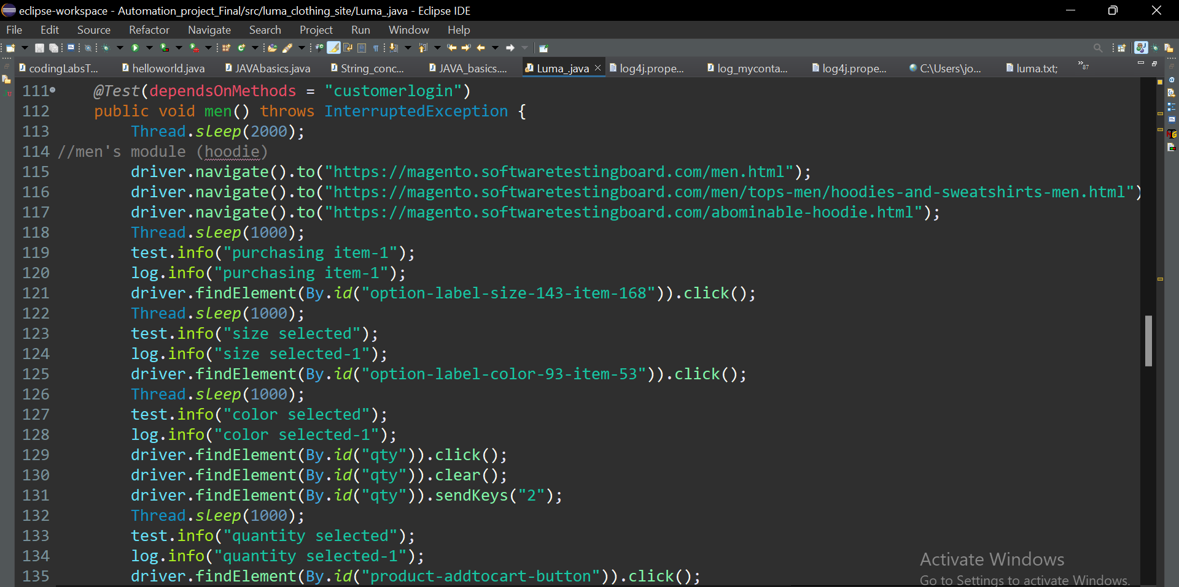
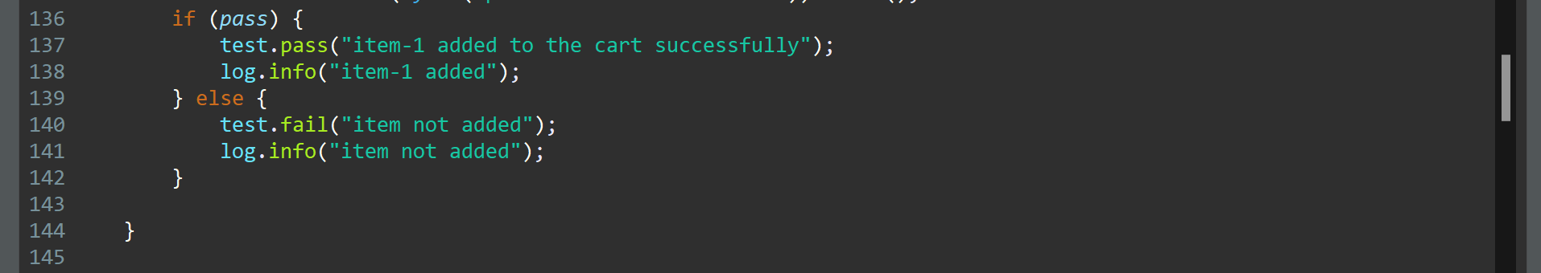
3.Men ()-

Slide 29
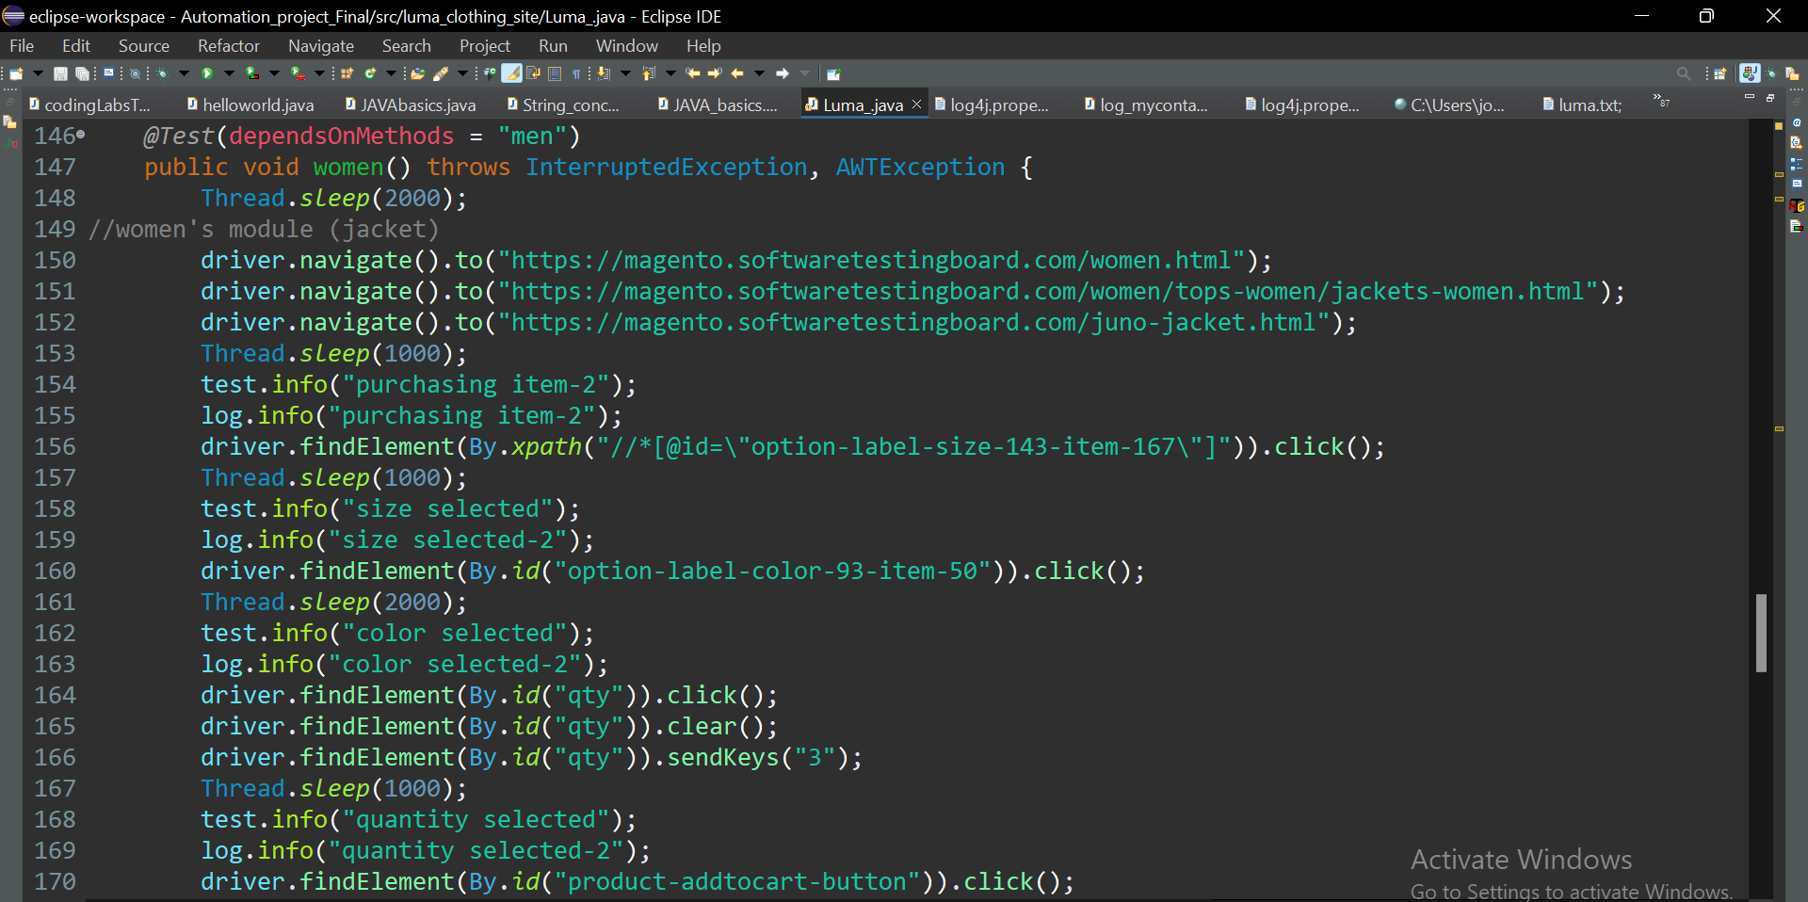
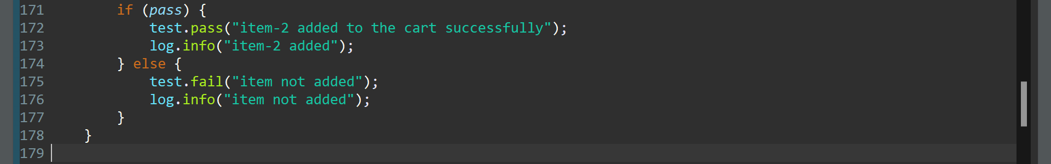
4.Women ()-

Slide 30
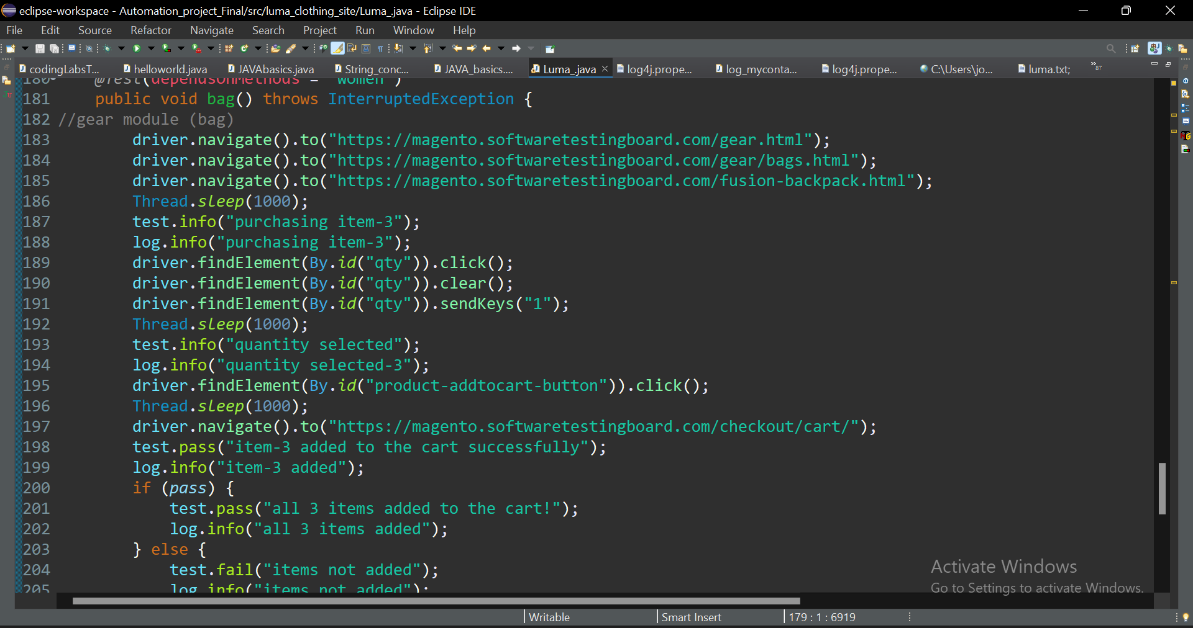
5.Bag ()-

Slide 31
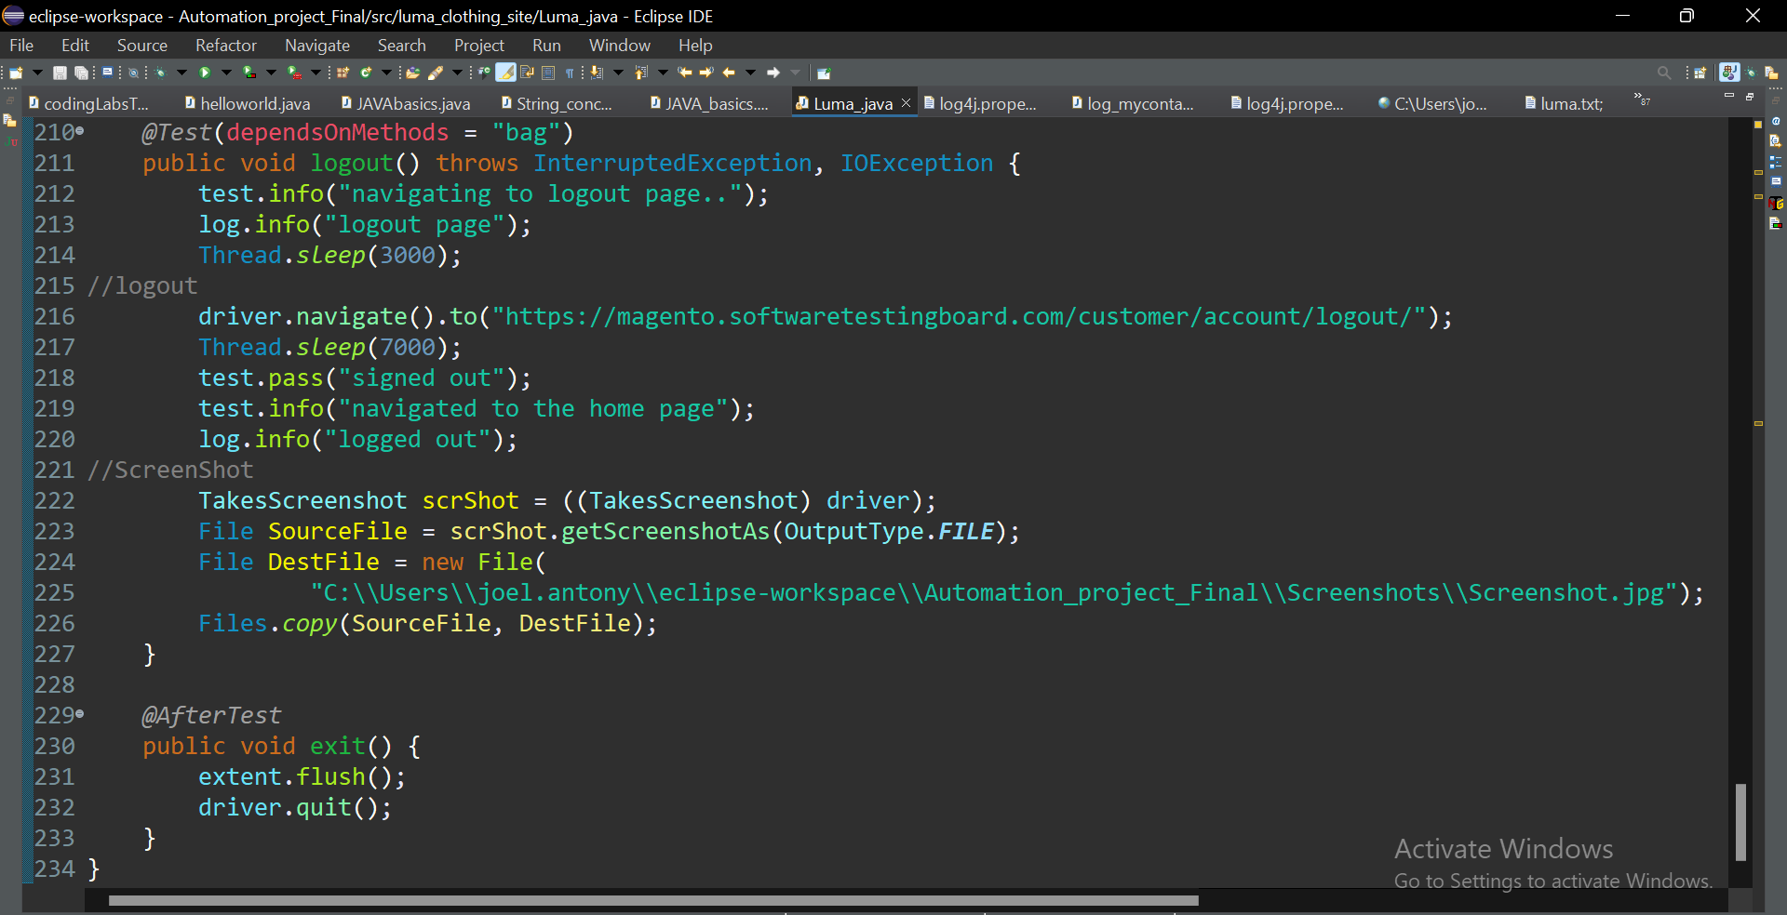
6.Logout ()-

Slide 32
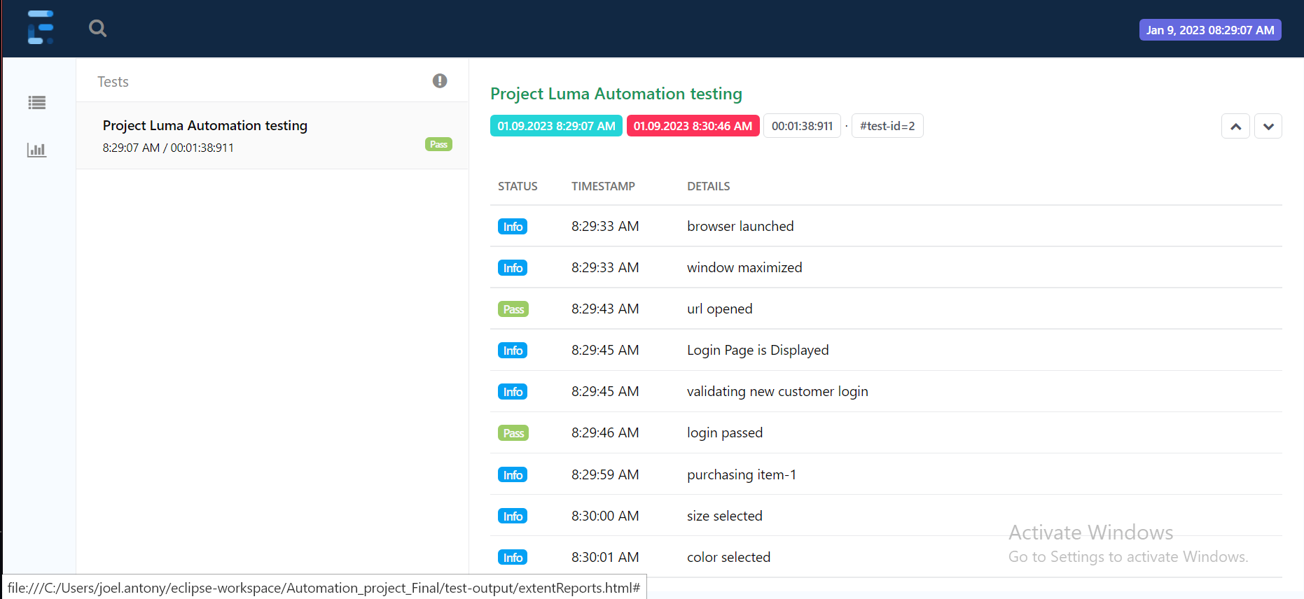
Extent Report

Slide 33
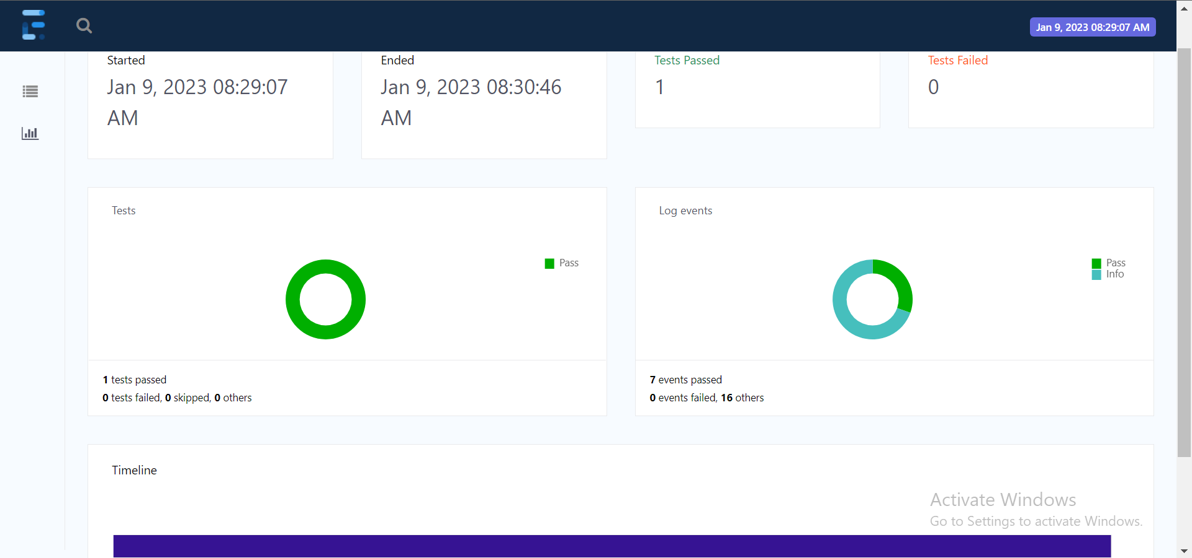

Slide 34
THANK YOU

